Slide 1


INTRODUCTION
TO UNIX
FILE SYSTEM
Session no :4
Operating System Design
@KL University, 2020

Slide 2
Understanding UNIX/Linux
File Systems
File: basic component for data storage
  UNIX considers everything to be a file
A file system is UNIX/Linux’s way of organizing files on mass storage devices
  A physical file system is a section of the hard disk that has been formatted to hold files
All data in Unix is organized into files. All files are organized into directories. These directories are organized into a tree-like structure called the file system.
@KL University , 2020

Slide 3
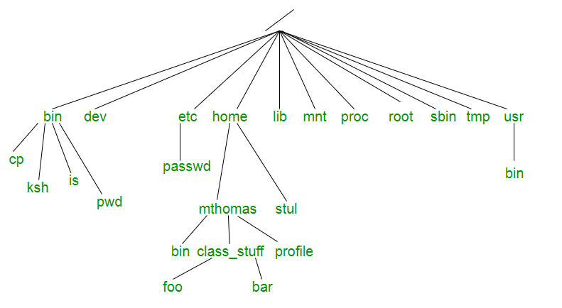
Unix File System
@KL University , 2020

Slide 4
Overview of the File system.
The internal organization of the file is given by an Inode.
The kernel contains two other data structures , the file table and the user file descriptor table .
The file table is a global kernel structure, but the user file descriptor table is allocated per process.
When a process opens or creates a file , the kernel allocates an entry from each table , corresponding to the file’s inode.
Entries in the three structures –user file descriptor table , file table and inode table maintain the state of the file and the user’s access to it.
The file table keeps track of the byte offset in the file where the user’s next read or write will start, and the access rights allowed to the opening process.
The user file descriptor table identifies all open files for a process.
@KL University , 2020

Slide 5
File system.
A file system consists of a sequence of logical blocks (512/1024 byte etc.)
Size of a logical block is homogeneous with in a file system
A file system has the following structure:
Boot Block | Super Block | Inode List | Data Blocks
File System Layout
@KL University , 2020

Slide 6
Why Buffer Cache
Kernel maintains files on mass storage
To access data ,kernel brings data into main memory
System response time and throughput is poor due to slow disk transfer rate
To minimize the frequency of disk accesses, maintains a pool of internal data buffers ,called the buffer cache.
While reading data from the disk ,kernel attempts to read from the buffer cache.
Data being written to disk is cached so that it will be there if the kernel later tries to read it.
@KL University , 2020

Slide 7
The Buffer cache
User program
User level
libraries
System call interface
Process
File system
ipc
Kernel
level
Buffer cache Control Subsystem
schedular
character
block
mm
Device driver
Hardware control
Hardw
are level
hardware
@KL University , 2020
block diagram of the System Kernel

Slide 8
Buffer Headers
During system initialization , the kernel allocates space for a number of buffers ,configurable according to memory size & system performance constraints.
Buffer
Memory array: Contains data from disk
Buffer header : Identifies the buffer
The buffer is the in-memory copy of the disk block.
A disk block can never map into more than one buffer at a time.
The buffer header contains a device number field and a block number field that specify the file system and block number of the data on disk and uniquely identifies the buffer.
@KL University , 2020

Slide 9
Status of buffer
Locked
Valid
Delayed write
Reading or writing
Waiting for free
Buffer header
Dev num
Block num
status
ptr to data area
ptr to previous buf on hash queue
ptr to next buf on the hash queue
ptr to previous buf on free list
ptr to next buf on free list
Figure : buffer header
@KL University , 2020

Slide 10
Structure of the Buffer Pool
Kernel caches data in the buffer according to LRU
Free List
Doubly linked circular list.
Every buffer is put on the free list when the system is booted.
When insert
  Push the buffer in the tail of the list ( usually )
  Push the buffer in the head of the list ( error case )
When take
  Choose first element
Hash Queue
Separate queues : each Doubly linked list
When insert
  Hashed as a function of device num, block num
@KL University , 2020

Slide 11
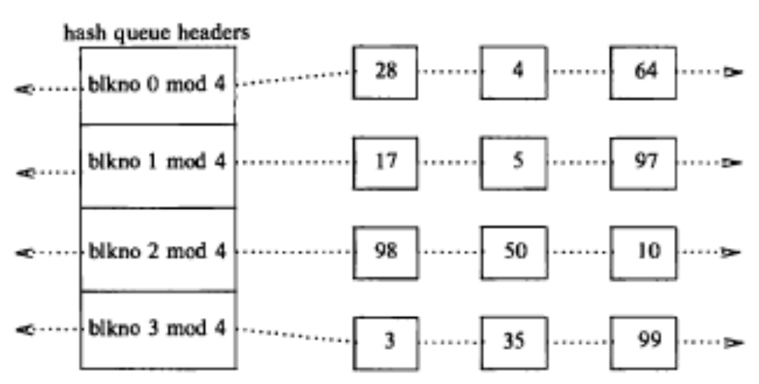
Buffers on the Hash Queues
@KL University , 2020

Slide 12
DESIGN

Slide 13
Scenarios to allocate a buffer for a disk block
1.The kernel finds the block on its hash queue, and its buffer is free.
2. The kernel cannot find the block on the hash queue, so it allocates a buffer from the free list.
3. The kernel cannot find the block on the hash queue and, in attempting to allocate a buffer from the free list (as in scenario 2), finds a buffer on the free list that has been marked "delayed write." The kernel must write the "delayed write" buffer to disk and allocate another buffer.
4. The kernel cannot find the block on the hash queue, and the free list of buffers is empty.
5. The kernel finds the block on the hash queue, but its buffer is currently busy.
@KL University , 2020

Slide 14
1st Scenario
Block is in hash queue, not busy
Choose that buffer
Blkno 0 mod 4 28 4
64
Blkno 1 mod 4
17 5
97
Blkno 2 mod 4
98
50
10
Blkno 3 mod 4
3
35
99
Freelist header
(a) Search for block 4 on first hash queue

Slide 15
1st Scenario
After allocating
Blkno 0 mod 4
64
28
4
Blkno 1 mod 4
17
97
5
Blkno 2 mod 4
98
50
10
Blkno 3 mod 4
3
35
99
Freelist header
(b) Remove block 4 from free list
@KL University , 2020

Slide 16
2nd Scenario
Not in the hash queue and exist in free buffer. Choose one buffer in front of free list.
Blkno 0 mod 4 28 4 64
Blkno 1 mod 4
17 5
97
Blkno 2 mod 4
98
50
10
Blkno 3 mod 4
3
35
99
Freelist header
(a) Search for block 18 – Not in the cache
@KL University , 2020

Slide 17
2nd Scenario
After allocating
Blkno 0 mod 4
64
28
4
Blkno 1 mod 4
17
97
5
Blkno 2 mod 4
98
50
10
18
Blkno 3 mod 4
35
99
Freelist header
@KL University , 2020
(b) Remove first block from free list, assign to 18

Slide 18
3rd Scenario
Not in the hash queue and there exists delayed write buffer in the front of free list
Write delayed buffer asynchronously and choose next
Blkno 0 mod 4 28 4
64
Blkno 1 mod 4
17
5
delay
97
Blkno 2 mod 4
98
50
10
Blkno 3 mod 4
3
35
99
delay
Freelist header
@KL University , 2020
(a) Search for block 18, delayed write blocks on free list

Slide 19
3rd Scenario
After allocating
Blkno 0 mod 4
28
64
Blkno 1 mod 4
17
97
5
writing
Blkno 2 mod 4
98
50
10
18
Blkno 3 mod 4
3
35
99
writing
Freelist header
(b) Writing block 3, 5, reassign 4 to 18
@KL University , 2020

Slide 20
4th Scenario
Not in the hash queue and no free buffer
Wait until any buffer free and re-do
Blkno 0 mod 4
Blkno 1 mod 4
Blkno 2 mod 4
Blkno 3 mod 4
 |  | 28 |  | 4 |  | 64
 |  | 17 |  | 5 |  | 97
 |  | 98 |  | 50 |  | 10
 |  | 3 |  | 35 |  | 99
Freelist header
(a) Search for block 18, empty free list
@KL University , 2020

Slide 21
4th Scenario
Process A
Process B
Cannot find block b on the hash queue
No buffer on free list
Sleep
Cannot find block b on hash queue
No buffers on free list Sleep
Somebody frees a buffer: brelse
Takes buffer from free list Assign to block b
Figure 3.10 Race for free buffer
@KL University , 2020

Slide 22
5th Scenario
Block is in hash queue, but busy
Wait until usable and redo
Blkno 0 mod 4 28 4
64
Blkno 1 mod 4
17 5
97
Blkno 2 mod 4
98
50
10
Blkno 3 mod 4
3
35
99
busy
Freelist header
@KL University , 2020
(a) Search for block 99, block busy

Slide 23
5th Scenario
Process A
Process B
Process C
Allocate buffer to block b
Lock buffer
Find block b on hash queue
Buffer locked, sleep
Initiate I/O
Sleep until I/O done
Sleep waiting for
any free buffer ( scenario 4 )
I/O done, wake up
brelse(): wake up others
Get buffer previously assigned to block b
reassign buffer to buffer b’
Buffer does not contain
block b
start search again
@KL University , 2020
time

Slide 24
Algorithm :getblk
algorithm getblk
Input: file system number block number
Output: locked buffer
that can now be used for block
{
while(buffer not found)
{
if(block in hash queue){ /*scenario 5*/ if(buffer busy){
sleep(event buffer becomes free) continue;
}
mark buffer busy; /*scenario 1*/ remove buffer from free list; return buffer;
}
else{
if ( there are no buffers on free list)
{ /*scenario 4*/
Sleep(event any buffer becomes free) continue;
}
remove buffer from free list;
if(buffer marked for delayed write)
{
/*scenario 3*/
asynchronous write buffer to disk; continue;
}
/*scenario 2*/
remove buffer from old hash queue; put buffer onto new hash queue; return buffer;
}
}}
@KL University , 2020

Slide 25
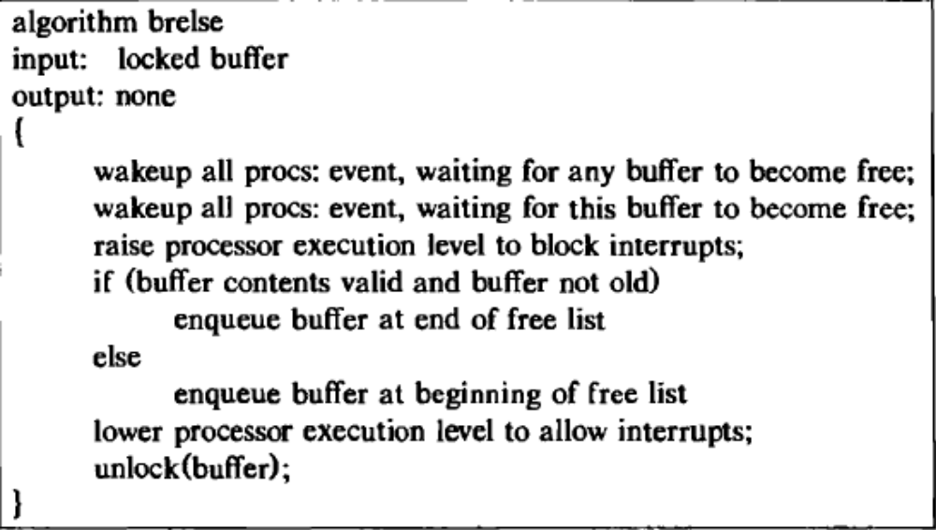
Algorithm :Brelse
@KL University , 2020

Slide 26
IMPLEMENTATION

Slide 27
Implementation XV6--bget
// Look through buffer cache for block on device dev
// If not found, allocate a buffer.
// In either case, return locked buffer.
static struct buf*
bget(uint dev, uint blockno)
{
struct buf *b;
acquire(&bcache.lock);
// Is the block already cached?
for(b = bcache.head.next; b != &bcache.head; b = b->next)
{
if(b->dev == dev && b->blockno == blockno)
{
b->refcnt++;
release(&bcache.lock);
acquiresleep(&b->lock);
return b;
}
}
// Not cached; recycle an unused buffer.
// Even if refcnt==0, B_DIRTY indicates a buffer is in use
// because log.c has modified it but not yet committed it.
for(b = bcache.head.prev; b != &bcache.head; b = b->prev)
{
if(b->refcnt == 0 && (b->flags & B_DIRTY) == 0)
{
b->dev = dev;
b->blockno = blockno;
b->flags = 0;
b->refcnt = 1;
release(&bcache.lock);
acquiresleep(&b->lock);
return b;
}
}
panic("bget: no buffers");
}
@KL University , 2020

Slide 28
Implementation XV6--brelse
// Release a locked buffer.
// Move to the head of the MRU list
Void brelse(struct buf *b)
{
if(!holdingsleep(&b->lock))
panic("brelse");
releasesleep(&b->lock);
acquire(&bcache.lock);
b->refcnt--;
if (b->refcnt == 0)
{
// no one is waiting for it.
b->next->prev = b->prev;
b->prev->next = b->next;
b->next = bcache.head.next;
b->prev = &bcache.head;
bcache.head.next->prev = b;
bcache.head.next = b;
}
release(&bcache.lock);
}
@KL University , 2020

